Slide 1

A
Project Presentation
on
“Software Testing Using Selenium IDE”
Ms. Rutuja Jalindar Athare(4104)
Ms. Urmila Uttam Barkade(4108)
Ms. Sanjivani Pandurang Dhande(4128)
Ms. Apeksha Bajirao Dhomse(4130)
Under The Guidance of Dr. S. K. Sonkar

Slide 2
Test Report on Amazon Online Shopping App :
Test Environment :
Browser: Chrome
Operating System: Windows
Devices: Desktop

Slide 3
Installation of Selenium :
Step 1: Download Selenium IDE Chrome Extension .
Step 2: Click On Add to Chrome.
Step 3: Check the icon on of IDE Square in right side of the
browser after installation to chrome.
Step 4: Now click on record button do some operation on website.
Step 5: See the report in console of IDE command, target and value.

Slide 4
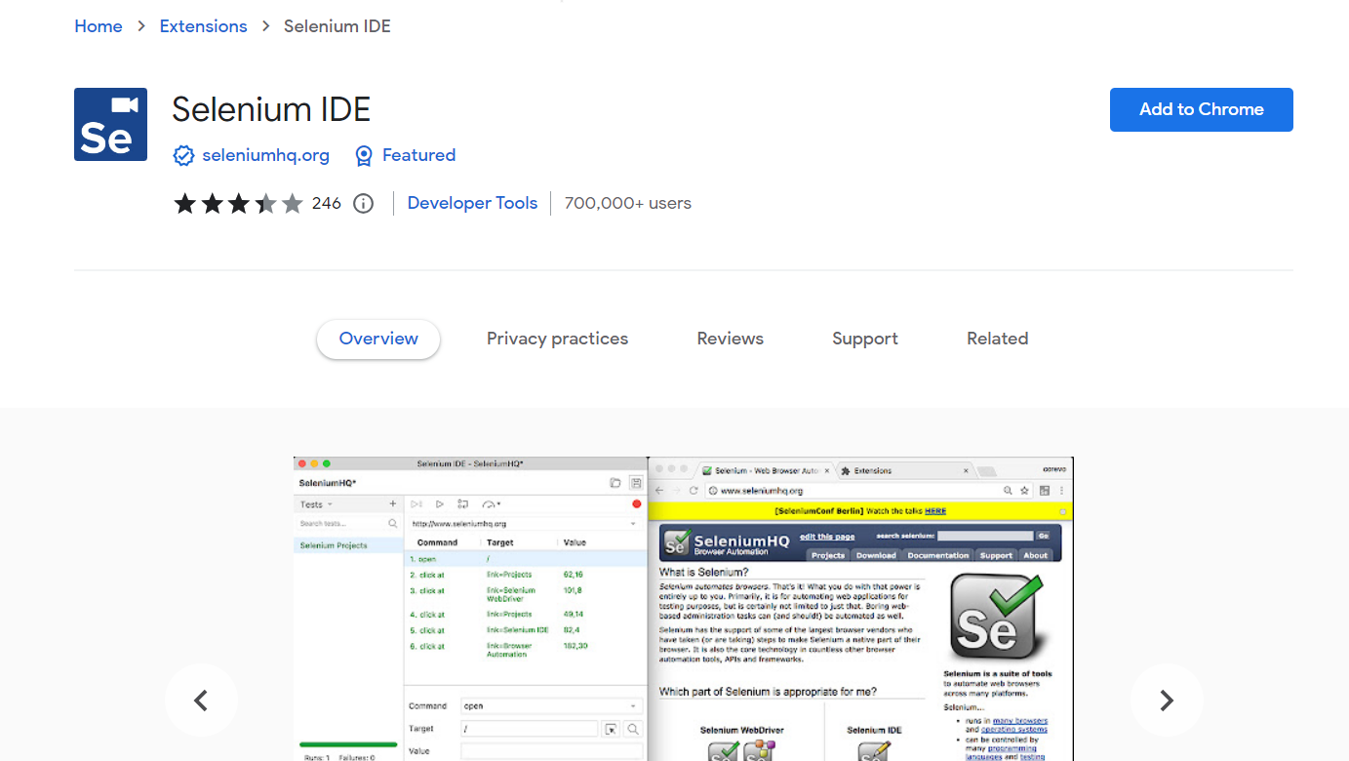

Slide 5
Test Cases For Our Amazon Online Shopping Application:
1. Verify User Registration.
2. Confirm that uses can log in with valid credentials.
3. Test the search bar by entering different types of product searches.
4. Check that clicking on a product shows detailed information.
5. Verify that users can add products to their cart.
6. Test the checkout process, including entering shipping and payment information.
7. Verify that users can complete the purchase successfully.
8. Test different payment methods.
9. Check that the users order history is updated after making a purchase.
10. Test various account settings like changing password, email, or contact information.

Slide 6
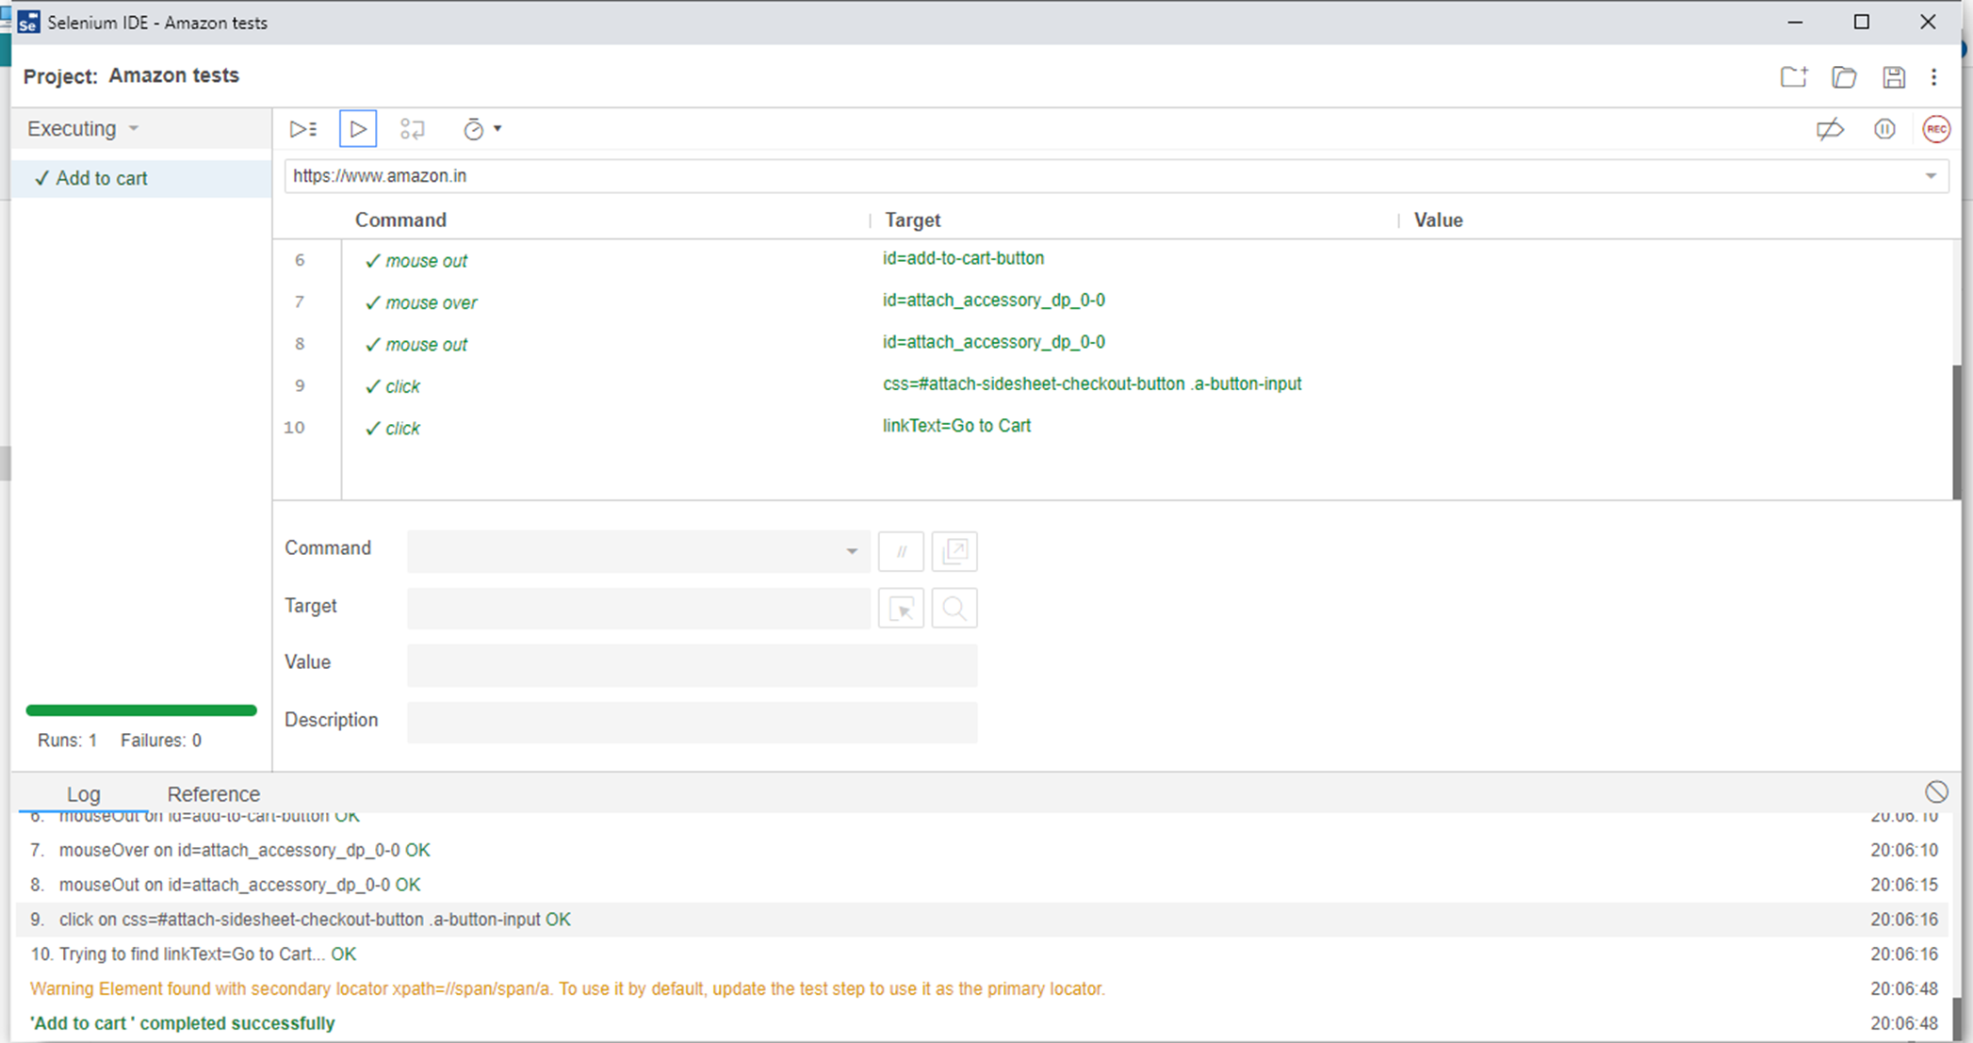
TEST 1: Add To Cart

Slide 7
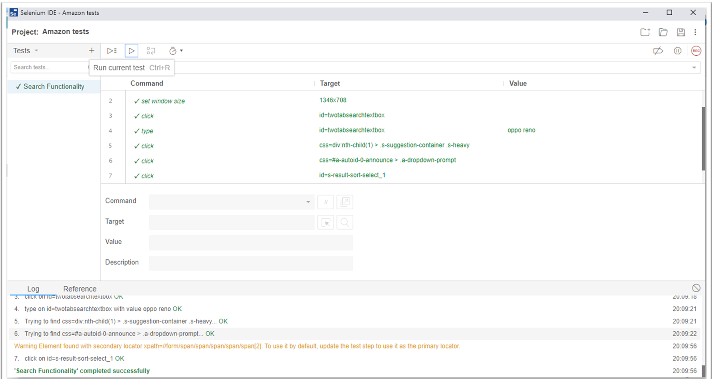
TEST 2: Search Functionality

Slide 8
Conclusion :
We have studied how to use Selenium IDE to test different types of web application like Amazon Online shopping website and understand the working of Selenium IDE.

